Slide 1

VEX IQ Robotics
Robotics Project
Notes:
As you present these slides, impress on the students the importance of following ALL of the instructions given in these slides and on the project rubric. The Robotics Notebook IS there project.

Slide 2
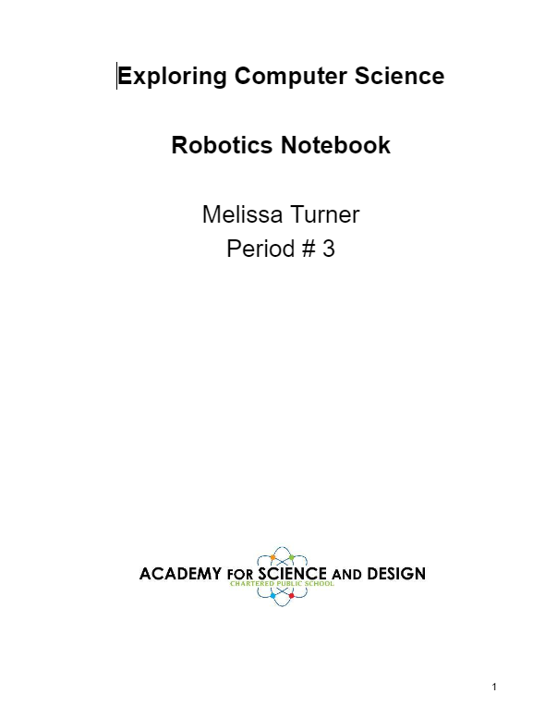

Project: Robotics Notebook
Your Notebook is your project
Follow the given template and instructions
Follow the rubric provided
Work on it every class day

Slide 3
Take Credit for Your Work!
Add your name and period number to the title page
Receive credit for all your hard work
Title page is part of the Project Rubric

Slide 4
Major Sections of Your Notebook
Here are the major sections of your notebook:
Project Information
Daily Entries
Robotic Builds
Assignments
Challenges
Class Notes

Slide 5
Table of Contents (ToC)
The pages immediately following your title page are for your Table of Contents or ToC
Each major section of your notebook is formatted as Heading 1
This makes finding your entries easier
Follow the instructions listed in the notebook template
The ToC is part of the Project Rubric

Slide 6
Daily Entries Section
All of your daily entries must begin with the day and date on a single line as follows:
Wednesday 11/16/2022
And then the text of your daily entry begins on the next line.
Daily entries are expected for EVERY day in class, even days you are absent.
Individual daily entries are NOT required as subheadings in the ToC
Provide substantial details. A single sentence is not sufficient!
The daily entries section is part of the Project Rubric
Your daily entries should NOT be Q&A style. They should be narrative style.
Include the following information in your Daily Entry:
What did you do?
What role did you play today? Record your role today. Some days you might do all three.
  Hardware Engineer (alternate every other build)
  Software Engineer (alternate every other build)
  Student
Did you have any problems come up? If so, did you solve them? How did you solve them?
What did you learn today?

Slide 7
Robot Builds Section
For each of your robot builds, you need an entry
Start it on new page with title (name of the robot build)
Can be more than one page as needed
Narrative description of your robot and this build task
  One or two paragraphs describing your robot and this task. Include any issues you had and how you overcame them. Did you enjoy doing the build? What was the best part?
A hand drawn sketch of your robot
  This is how you are going to build it and you can use the instructions photo as a guide.
  Scan or photograph it and insert into your notebook
A block diagram of your robot for electrical connections
  Robot brain
  All motors connected
  Any connected sensors
  The port numbers where connected to your robot brain
  Include controller if used with this build
Insert a picture of your finished robot
Must be included in the table of contents (ToC) by name of robot build
Part of the Project Rubric

Slide 8
Challenges Section
On its own page
Title at the top: What was the name of the challenge
One or more paragraphs describing the challenge
A sketch or photo of the challenge
Did you have an difficulties? If so, how did you overcome them?
What was the result of the challenge?
Must be included in the table of contents (ToC)
Part of the Project Rubric

Slide 9
Assignments Section
Can come from your VEX IQ Workbook, VEX VR, or Google Classroom
Complete all assignments in your Robotics Notebook
Start on a new page with title at the top
Title is formatted as a Header 2
Must be included in the table of contents (ToC)
Part of the Project Rubric

Slide 10
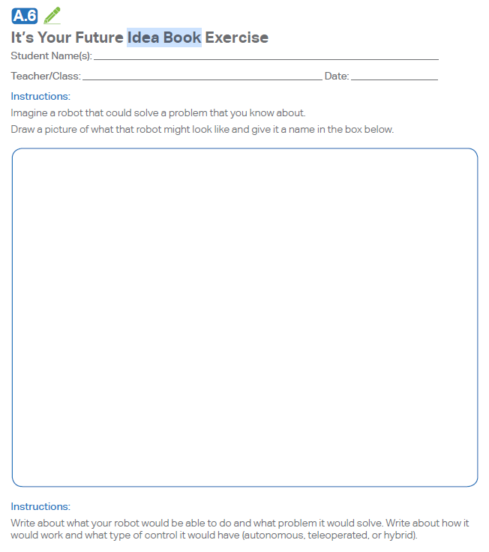
Idea Book Entries
From your VEX IQ Workbook
Complete all assigned Idea Book entries in the Assignments section of your Robotics Notebook
Start on a new page with title at the top
Include the section letter and subsection number (in this case A.6)
Must be included in the table of contents (ToC)
Part of the Project Rubric
Excerpt from the VEX IQ Workbook

Slide 11

Class Notes Section
Include any personal notes you wish to take during the robotics portion of this course
No specified format, make it your own style
Individual entries DO NOT need to be included in the table of contents (ToC)
Part of the Project Rubric

Slide 12
This is Your Project
This notebook IS your project, so keep it neat, organized and complete.
It is the record of what you did during the robotics portion of this course.
Work on it every class day.
Getting behind will make it hard to catch up.
Each project is 25% of your final grade in this course.
Submit it on time so you don’t suffer a late penalty.

Slide 13

The END be cool!

